Slide 1
Physical Education
Promoting A Lifetime of Healthy Activity (ALOHA)
Objective 10
Adopt at least one policy to require annual courses in Health Education and Physical Education from grades K-8, in the Department of Education, that are aligned with national recommendations for instructional time and teacher licensing.

Slide 2
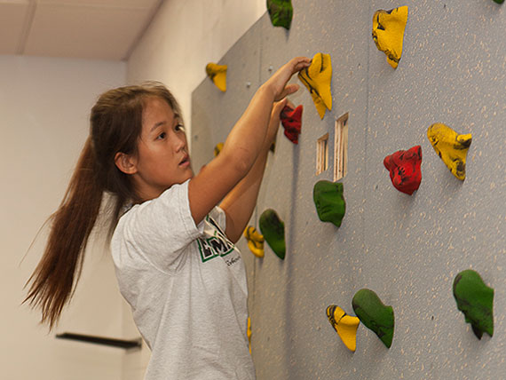
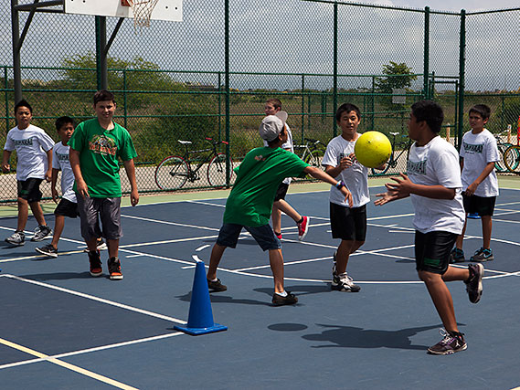
Physical Education
Promoting A Lifetime of Healthy Activity (ALOHA)
Physical Education Foundation
Why?
Goal - A Lifetime of Healthy Activity (ALOHA) PE
How?
Comprehensive School Physical Activity Program (CSPAP)
What?
Standards for K-12 Physical Education
Who?
Partnerships

Slide 3
Physical Education
Promoting A Lifetime of Healthy Activity (ALOHA)
Why: A Lifetime of Healthy Activity
(ALOHA PE)
The goal of physical education is to develop physically literate individuals who have the knowledge, skills, and confidence to enjoy a lifetime of healthful physical activity.
ALOHA PE Project Video Competition - Student Videos
https://bit.ly/2024ALOHAPEentryform

Slide 4
Physical Education
Promoting A Lifetime of Healthy Activity (ALOHA)
Benefits of Physical Activity
Physical
Emotional
Cognitive
Reduced chance of obesity
Reduced risk for chronic diseases
Reduced feelings of depression and anxiety
Promotes psychological well-being
Improved attention & concentration
Memory
Academic Achievement

Slide 5
Physical Education
Promoting A Lifetime of Healthy Activity (ALOHA)
How: Comprehensive School Physical Activity Program (CSPAP)
SHAPE America - CSPAP Position Statement
NEW release
CSPAP Self-Assessment Tool
Actionable now
Active Learning for Academic Achievement
PD Credit course (Fall, Winter, Spring)
PD Non-credit course
(February - Active Classrooms Month)
1-2 Hour PD training for school staff

Slide 6
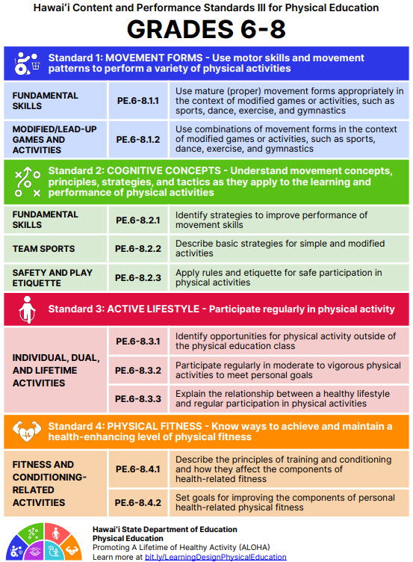
Physical Education
Promoting A Lifetime of Healthy Activity (ALOHA)
What: Standards for Physical Education
Hawaii - HCPS III
National - SHAPE America
SY 24-25 - Future revision of State Physical Education Standards (2-3 year process)
Latest Draft Version of the SHAPE America National Physical Education Standards

Slide 7
Physical Education
Promoting A Lifetime of Healthy Activity (ALOHA)
Who: DOH, HAHPERD, UH Manoa COE

Slide 8
Physical Education
Promoting A Lifetime of Healthy Activity (ALOHA)
Recap: Physical Education Foundation
Why?
Goal - A Lifetime of Healthy Activity (ALOHA) PE
How?
Comprehensive School Physical Activity Program (CSPAP)
What?
Standards for K-12 Physical Education
Who?
Partnerships

